Slide 1
GLOBAL BANK USER MANAGEMENT SYSTEM
Team MEMBERS:
MOHAMMED AHMED KHAN
DHANUSH
KAUSTUBH
DHRISHA
DHRUV

Slide 2
Scope:
Goal is to build a Global Bank User Management System that has following features:
User has the ability to create an account and login.
User can apply for loan.
User can perform Deposit/Withdraw operations.
User can view statement of all his transactions.

Slide 3
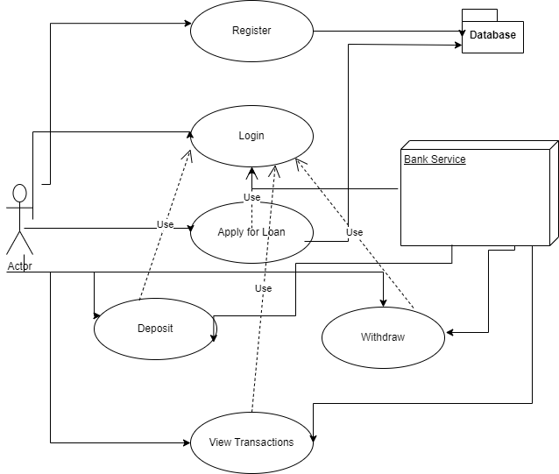
Usecase diagram

Slide 4
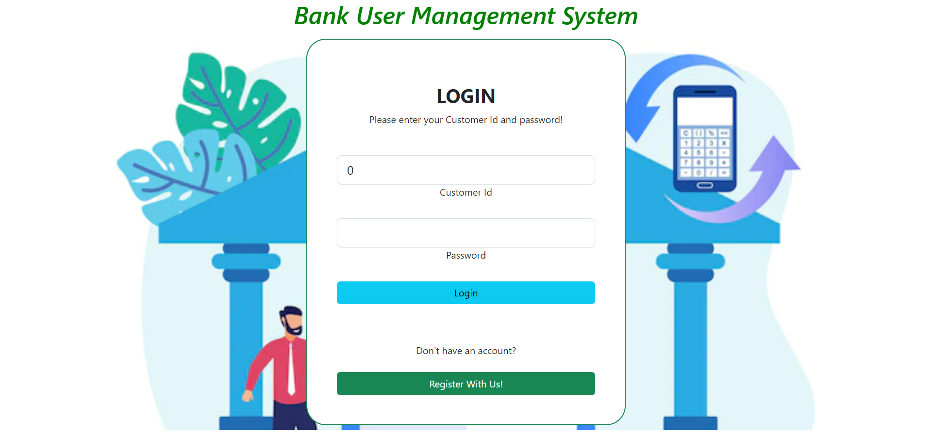
Snapshots of application
Login Page:

Slide 5
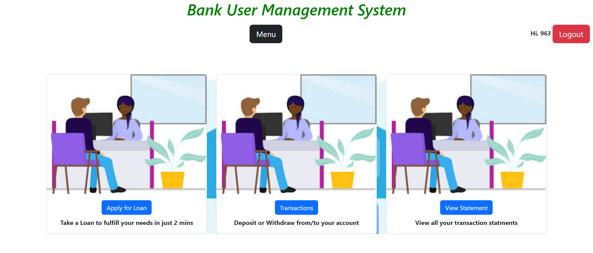
Menu Page

Slide 6
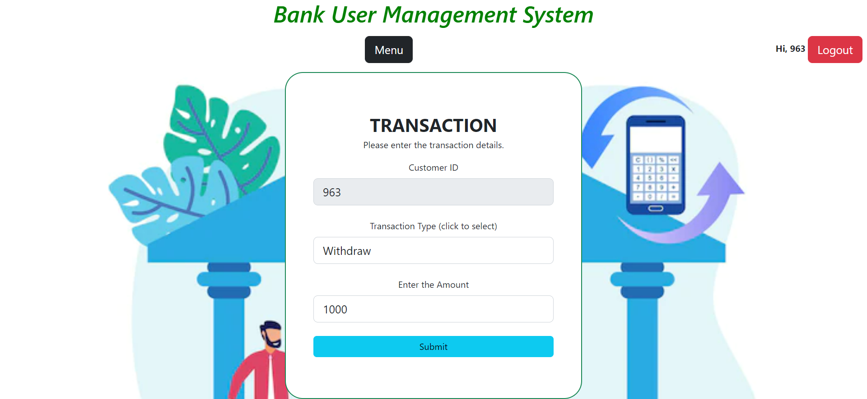
Transaction types

Slide 7
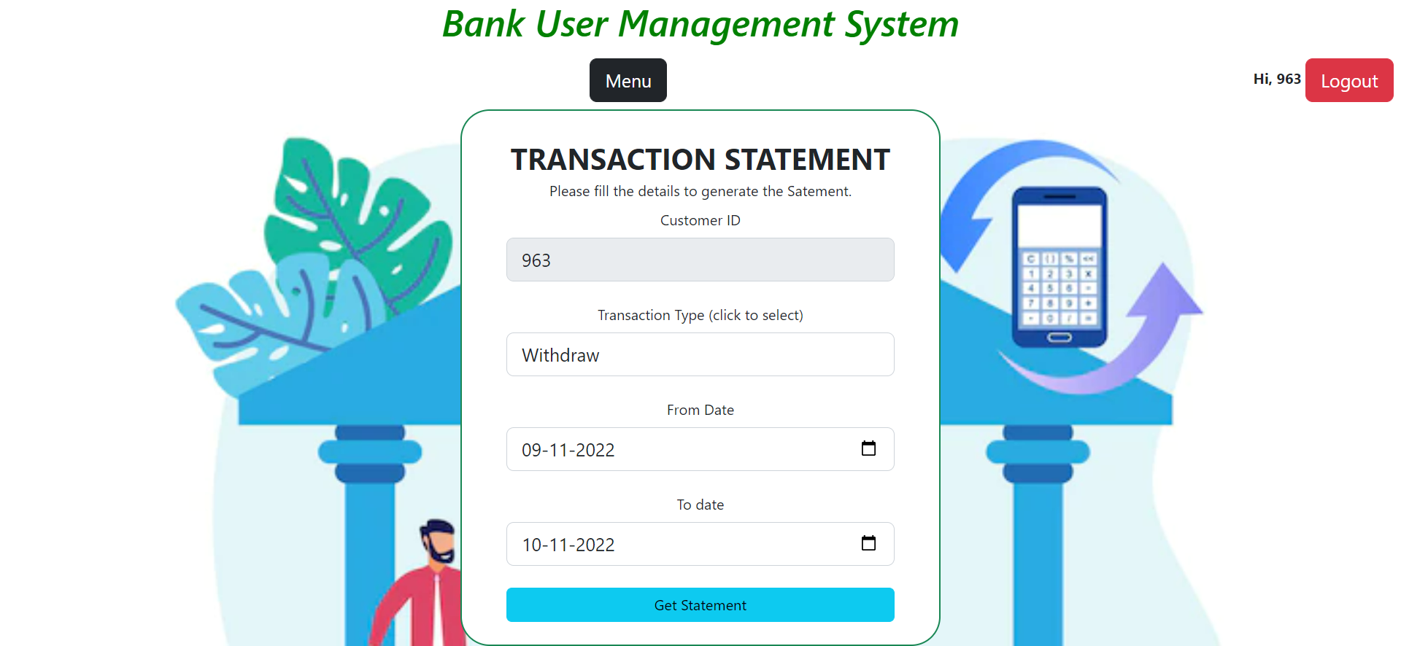
Transaction Statement

Slide 8
Thank you

